Slide 1

Final Design Review
Notes:
Chara: 60 seconds

Slide 2
Problem Statement
Concept Model
Problem
Target Market
There is a need for a humane, efficient way to detect and promptly respond to mouse infestations.
Eco-conscious consumers
No-contact solution seekers
Busy individuals needing alerts
Notes:
Noah

Slide 3

Mechanical Aspect
Notes:
Noah:
-TrapSync

Slide 4
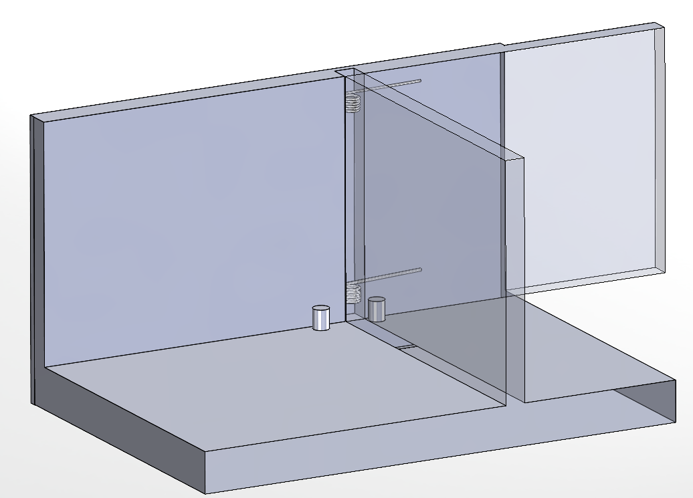
Previously on TrapSync...
Double-Pin Door
Concept Model
Notes:
Noah: make this 30 seconds

Slide 5
Final Design Strategy: NEM
Design Constraints (C) And Objectives (O) | Propeller Door | Double-Pin Door | Solenoid Draw-Bridge
C: Must be big enough to fit a large mouse | 3 | 3 | 3
C: Must be small enough to fit in tight spaces | 2 | 3 | 2.5
C: No sharp edges | 3 | 3 | 3
C: Must be reusable | 3 | 2.5 | 3
C: Must not injure the mouse or human on closing | 3 | 3 | 3
O: Portable | 3 | 3 | 3
O: Close the price of a common mouse trap, Sub 20$, at selling | 3 | 3 | 1
O: Quick trap | 2.5 | 3 | 2
O: Quick alert | 3 | 3 | 3
O: Cleanable | 2.5 | 3 | 2.5
Notes:
Noah:

Slide 6
Final Design Strategy: NEM
Design Constraints (C) And Objectives (O) | Propeller Door | Double-Pin Door | Solenoid Draw-Bridge
C: Must be big enough to fit a large mouse | 3 | 3 | 3
C: Must be small enough to fit in tight spaces | 2 | 3 | 2.5
C: No sharp edges | 3 | 3 | 3
C: Must be reusable | 3 | 2.5 | 3
C: Must not injure the mouse or human on closing | 3 | 3 | 3
O: Portable | 3 | 3 | 3
O: Close the price of a common mouse trap, Sub 20$, at selling | 3 | 3 | 1
O: Quick trap | 2.5 | 0 | 2
O: Quick alert | 3 | 3 | 3
O: Cleanable | 2.5 | 3 | 2.5
Notes:
Noah:

Slide 7
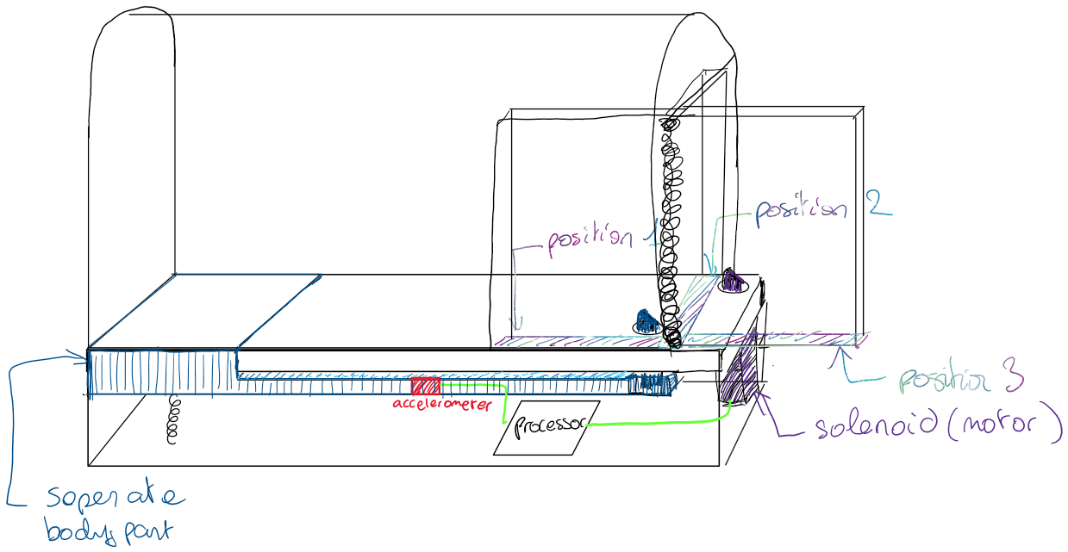
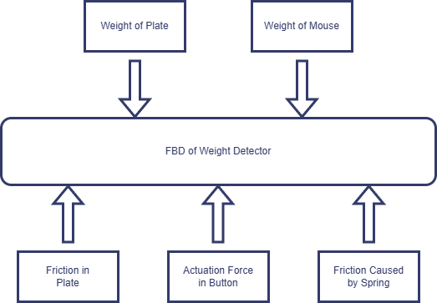
Reason for Rejection
Reason for Rejection
Notes:
Noah: 60 seconds

Slide 8
Final Design Strategy: NEM
Design Constraints (C) And Objectives (O) | Propeller Door | Double-Pin Door | Solenoid Draw-Bridge | Servo Door
C: Must be big enough to fit a large mouse | 3 | 3 | 3 | 3
C: Must be small enough to fit in tight spaces | 2 | 3 | 2.5 | 3
C: No sharp edges | 3 | 3 | 3 | 3
C: Must be reusable | 3 | 2.5 | 3 | 3
C: Must not injure the mouse or human on closing | 3 | 3 | 3 | 3
O: Portable | 3 | 3 | 3 | 3
O: Close the price of a common mouse trap, Sub 20$, at selling | 3 | 3 | 1 | 3
O: Quick trap | 2.5 | 0 | 2 | 3
O: Quick alert | 3 | 3 | 3 | 3
O: Cleanable | 2.5 | 3 | 2.5 | 3
Notes:
Noah:

Slide 9
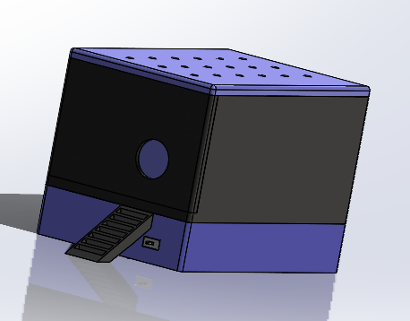
Final Design
Notes:
Noah

Slide 10


Morph Chart: Mechanical
Concept Model
Mechanical | 1 | 2 | 3 | 4 | 5 | 6
Closes Trap | Indirect Motor on door | Direct Motor on Door | Propeller trapdoor | Spring-loaded | … | …
Holds Mouse | Articulated Tent | Door-Based Square Cage | Snare and Rope | Bucket | Metal Cage | …
Opens Trap | Motor Winding | Manual Lever | Latch-Release | Solenoid Release | ... | …
Material for Cage | ABS | Wood | PLA | PETG | Aluminum | Electro-plated plastic
Notes:
TC

Slide 11
Morph Chart: Mechanical
Concept Model
Mechanical | 1 | 2 | 3 | 4 | 5 | 6
Closes Trap | Indirect Motor on door | Direct Motor on Door | Propeller trapdoor | Spring-loaded | … | …
Holds Mouse | Articulated Tent | Door-Based Square Cage | Snare and Rope | Bucket | Metal Cage | …
Opens Trap | Motor Winding | Manual Lever | Latch-Release | Solenoid Release | ... | …
Material for Cage | ABS | Wood | PLA | PETG | Aluminum | Electro-plated plastic
Notes:
TC

Slide 12
Morph Chart: Mechanical
Concept Model
Mechanical | 1 | 2 | 3 | 4 | 5 | 6
Closes Trap | Indirect Motor on door | Direct Motor on Door | Propeller trapdoor | Spring-loaded | … | …
Holds Mouse | Articulated Tent | Door-Based Square Cage | Snare and Rope | Bucket | Metal Cage | …
Opens Trap | Motor Winding | Manual Lever | Latch-Release | Solenoid Release | ... | …
Material for Cage | ABS | Wood | PLA | PETG | Aluminum | Electro-plated plastic
Notes:
TC

Slide 13
Morph Chart: Mechanical
Concept Model
Mechanical | 1 | 2 | 3 | 4 | 5 | 6
Closes Trap | Indirect Motor on door | Direct Motor on Door | Propeller trapdoor | Spring-loaded | … | …
Holds Mouse | Articulated Tent | Door-Based Square Cage | Snare and Rope | Bucket | Metal Cage | …
Opens Trap | Motor Winding | Manual Lever | Latch-Release | Solenoid Release | ... | …
Material for Cage | ABS | Wood | PLA | PETG | Aluminum | Electro-plated plastic
Notes:
TC

Slide 14
Morph Chart: Mechanical
Concept Model
Mechanical | 1 | 2 | 3 | 4 | 5 | 6
Closes Trap | Indirect Motor on door | Direct Motor on Door | Propeller trapdoor | Spring-loaded | … | …
Holds Mouse | Articulated Tent | Door-Based Square Cage | Snare and Rope | Bucket | Metal Cage | …
Opens Trap | Motor Winding | Manual Lever | Latch-Release | Solenoid Release | ... | …
Material for Cage | ABS | Wood | PLA | PETG | Aluminum | Electro-plated plastic
Notes:
TC

Slide 15
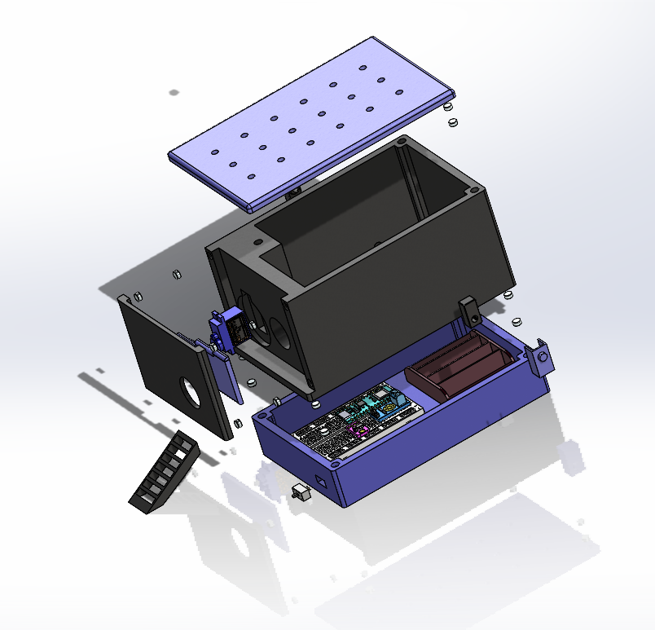
Exploded View
Concept Model
Notes:
Chara

Slide 16
Notes:
Chara

Slide 17
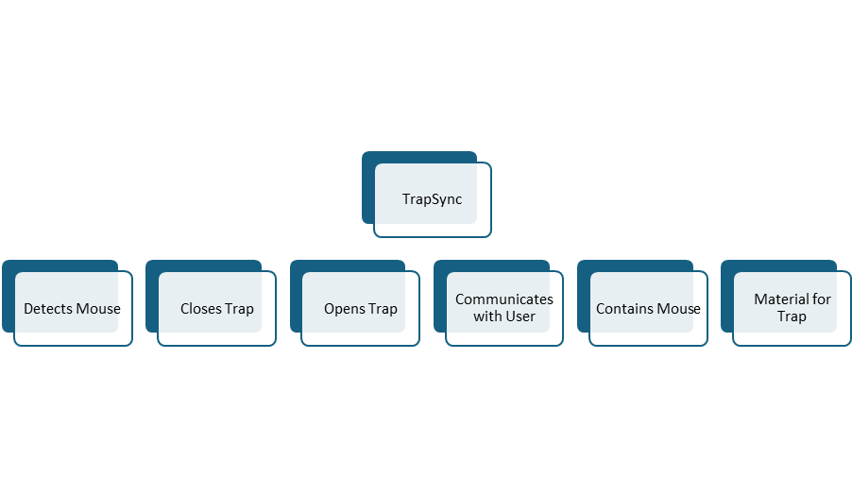
Function-Means Tree

Slide 18
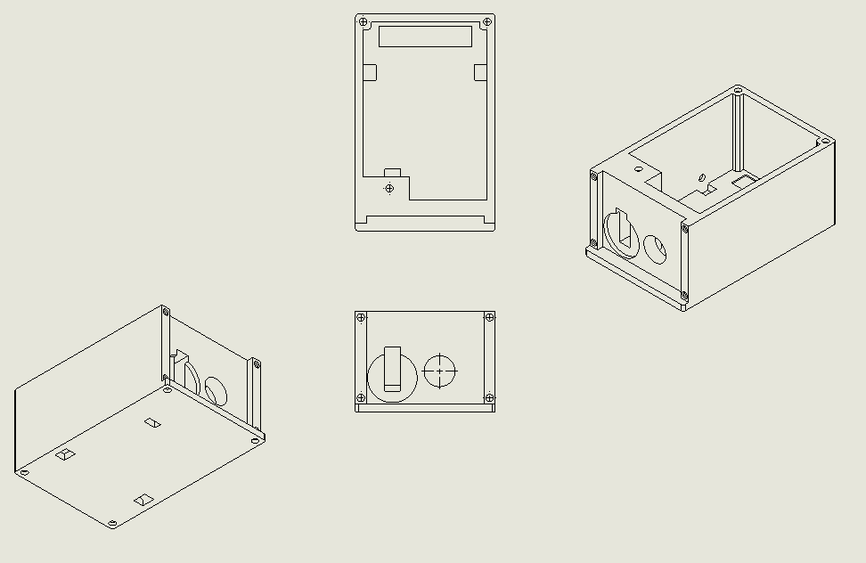
Concept Model
Function: Contains Mouse
Trap Casing

Slide 19
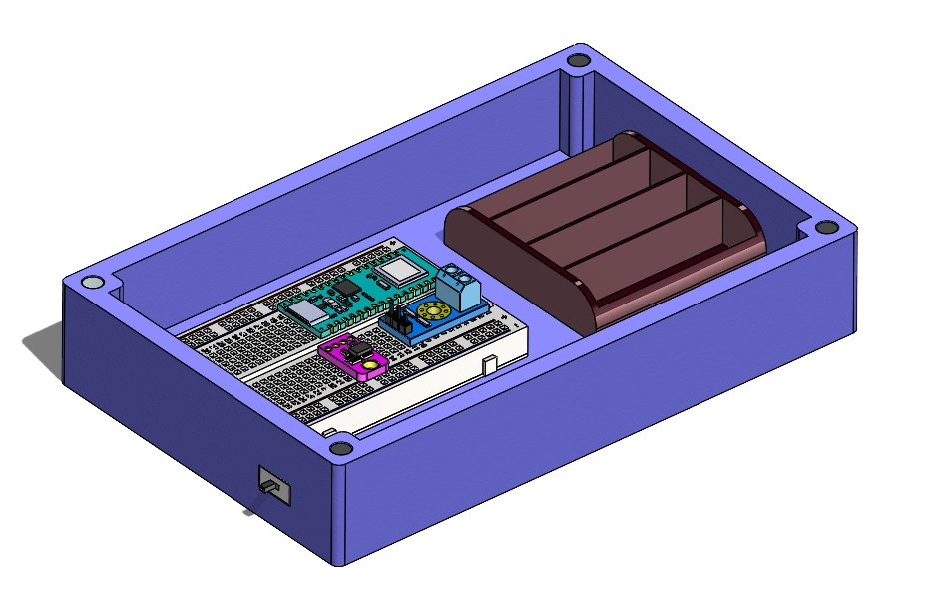
Concept Model
Function: Houses Electronics
Base Plate
Notes:
K

Slide 20
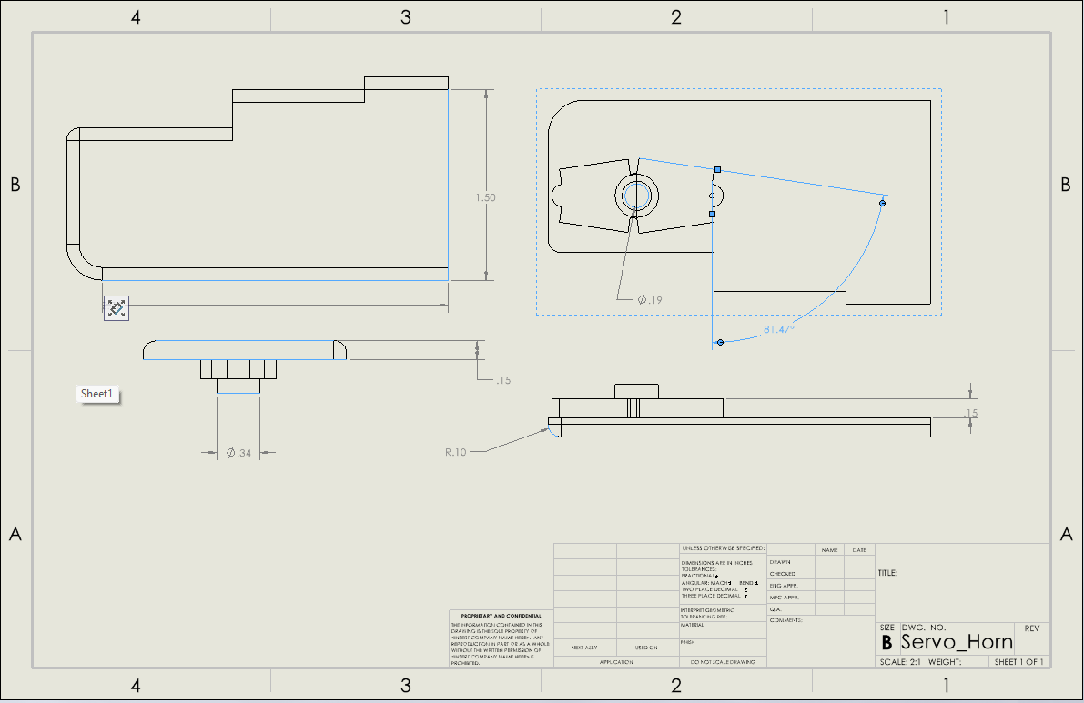
Concept Model
Function: Closes Trap
Door Shape

Slide 21

Electrical Aspect
Notes:
Kailyn

Slide 22
Morph Chart: Electrical
Concept Model
Electrical | 1 | 2 | 3 | 4
Detects Mouse | Electrical Weight sensors | Motion Sensors | Laser detection | Video Recognition
Control System | Arduino Uno | Raspberry Pi Pico | Raspberry Pi Zero | Arduino Nano
Communication | Bluetooth | Wi-Fi | UART | SPI
Notes:
K:60 seconds, WIFI EXPLANATION

Slide 23
Morph Chart: Electrical
Concept Model
Electrical | 1 | 2 | 3 | 4
Detects Mouse | Electrical Weight sensors | Motion Sensors | Laser detection | Video Recognition
Control System | Arduino Uno | Raspberry Pi Pico | Raspberry Pi Zero | Arduino Nano
Communication | Bluetooth | Wi-Fi | UART | SPI
Notes:
K

Slide 24
Morph Chart: Electrical
Concept Model
Electrical | 1 | 2 | 3 | 4
Detects Mouse | Electrical Weight sensors | Motion Sensors | Laser detection | Video Recognition
Control System | Arduino Uno | Raspberry Pi Pico | Raspberry Pi Zero | Arduino Nano
Communication | Bluetooth | Wi-Fi | UART | SPI
Notes:
K

Slide 25
Morph Chart: Electrical
Concept Model
Electrical | 1 | 2 | 3 | 4
Detects Mouse | Electrical Weight sensors | Motion Sensors | Laser detection | Video Recognition
Control System | Arduino Uno | Raspberry Pi Pico | Raspberry Pi Zero | Arduino Nano
Communication | Bluetooth | Wi-Fi | UART | SPI
Notes:
K

Slide 26
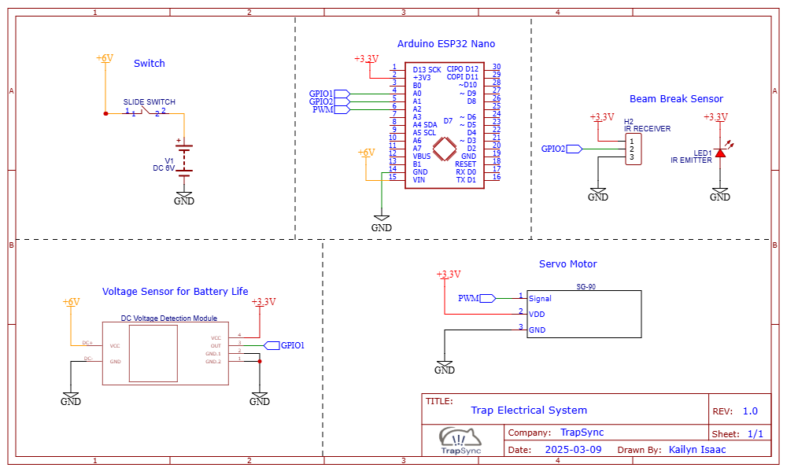
Electrical Schematic: Initial Prototype
Concept Model
Notes:
K:20 seconds
-

Slide 27
Notes:
K

Slide 28
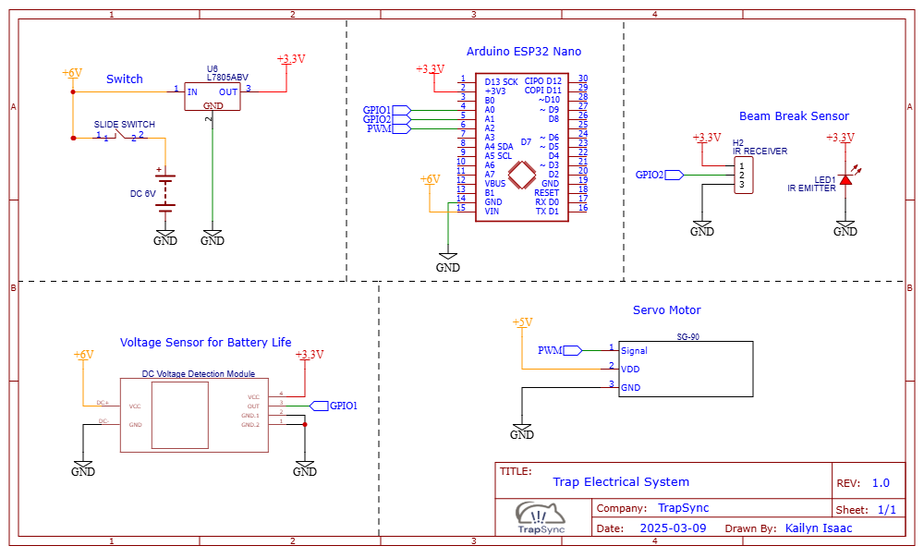
Electrical Schematic: Final Prototype
Concept Model
Notes:
K:20 Seconds

Slide 29
Notes:
K

Slide 30
Arduino ESP32 Nano
Concept Model
Notes:
K :1

Slide 31
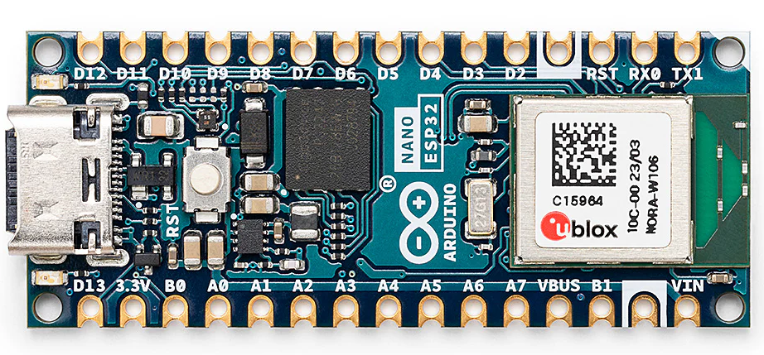
Concept Model
Name | Price | Type | RAM | Storage | Integrated Wi-Fi
Raspberry Pi | ++ | Computer board (needs boot setup) | 3GB | Micro SD card | Yes
Arduino Uno | -- | Runs on boot after uploading | 2kB | 32KB Flash | No
Arduino Micro | $21 | Runs on boot after uploading | 2.5kB | 32KB (4kB bootloader used) | No
Arduino Nano ESP32 | $21 | Wi-Fi®, Bluetooth® | 512 kB |  | Yes
Name | Supply Needed | Max Draw | Operating Voltage | I/O Pins
Arduino Uno | 7-12V | Max 50mA @ 3.3V | 5V | 14
Arduino Micro | 7-12V | Max 50mA @ 3.3V | 5V | 20
Arduino Nano ESP32 | 6-24V | 7μA deep sleep, 240μA light sleep | 3.3V | 34
Function: Communicates with User
Microprocessor
Notes:
K

Slide 32
Concept Model
Notes:
K

Slide 33
Voltage Regulator
Concept Model
Notes:
K:45

Slide 34
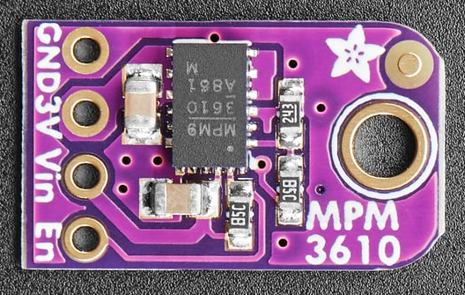
Voltage Regulators | Source | Input Voltage | Output Voltage | Max Current | Plug Type | Price
Mini360 Regulator (5pcs) | Amazon | 4.5-24V | 3.3V | 1.8A | Micro USB | $9.59
Adafruit Regulator MPM361 | Adafruit | 4.5 to 21V | 3.3V | 1.2A | 4 Pins | $5.95
Voltage Regulator
Notes:
K

Slide 35
Concept Model
Notes:
K

Slide 36
Voltage Sensor
Concept Model
Notes:
K: 45

Slide 37
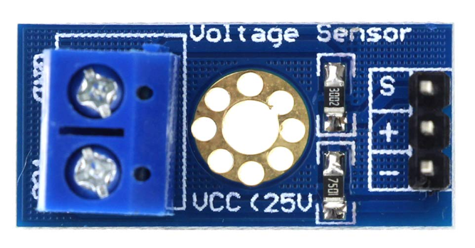
Voltage Sensor | Source | Price | Input | Detection range
Dittao Voltage Sensor | Amazon | $4.99 | 0-25V | 0.00489V
HiLetgo Voltage Sensor | Amazon | $5.89 | 0-25V | 0.02445 V
Voltage Sensor
Notes:
K

Slide 38
Concept Model
Notes:
K

Slide 39
Servo Motor
Concept Model
Notes:
K:45

Slide 40
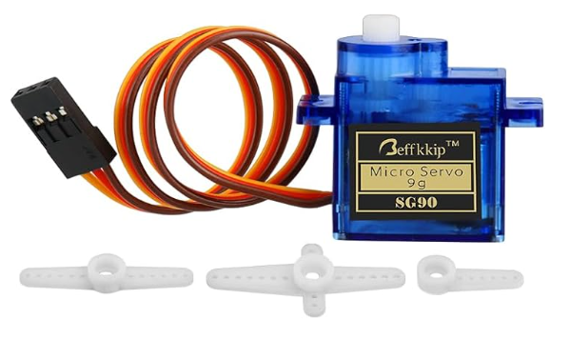
Servo Motors | Source | Power Requirements | Rotational Speed (no load) | Torque per cm | Price (For 4)
Servo Motor MG995 (for 6V) | Amazon | 6.0V-7.5V | 0.13 sec/60° | 12 kg/cm | $16.99
SG90 9g Micro Servo Motor (for 4.8V) | Amazon | 4.8V–6.6V | 0.10 sec/60° | 1.2-1.4 kg/cm | $7.99
Servo Motor
Function: Closes Trap, Open Trap
Notes:
K

Slide 41
Concept Model
Notes:
K

Slide 42
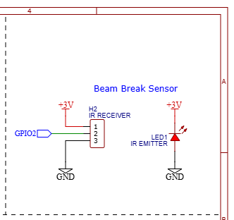
Beam Break Sensor
Concept Model
Notes:
K:1

Slide 43
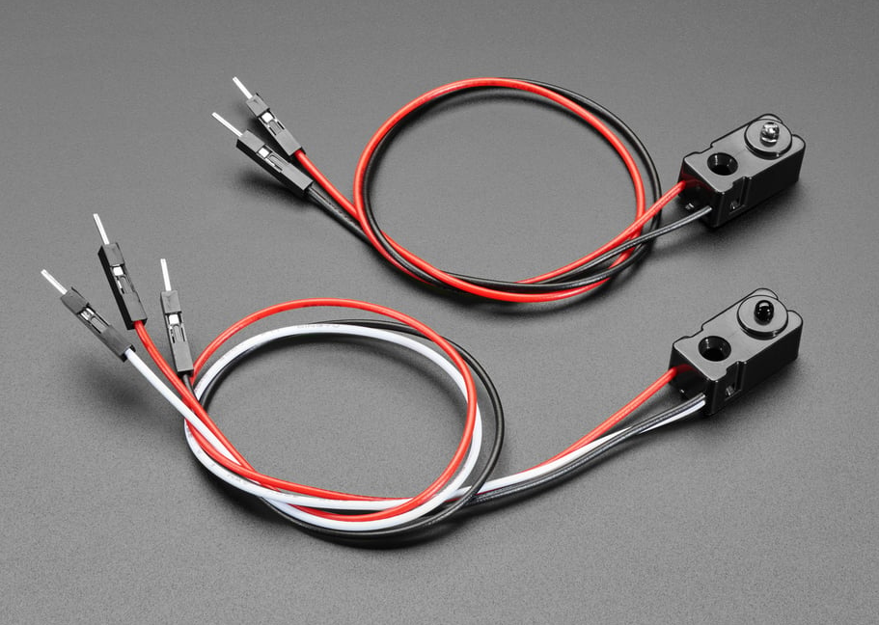
Sensors | Source | Power Requirements | Additional Info | Range/Sensibility | Price
Reflected Sensor | Adafruit | 5V | Needs extra resistor network | 2mm to 10mm | $1.95
IR Break Beam Sensor | Adafruit | 3.3V-5V | 3mm LED | 25cm / 10" | $2.95
 | Adafruit | 3.3V-5V | 5mm LED | 50cm / 20" | $5.95
Sensors
Function: Detects Mouse
Notes:
K

Slide 44

Software Integration
Concept Model
Electrical Engineer
Software Engineer
Update "Mouse Sensed" variable in database with ESP32 from sensor wake-up
Check for value update on "Open" variable
Create database in Firebase
Check for "Mouse Sensed" variable
Update "Open" variable in database
Notes:
K: 60 seconds
Case Model: explains the relationship between features in the app and how the user, animal, and databases interact with one another

Slide 45

Power Consumption
Concept Model
Component | I(A) | V(V) | Power(W)
NANO Esp432 | 150 μA deep sleep mode with ULP on | 3.3V | 0.000495
 | with Wifi modem:18.33mA on average | 3.3V | 0.06039
Beam Break Sensor | 10mA | 3.3V | 0.033
Servo | .19A | 5V | 0.95
Battery | 4 Rechargeable Alkaline Batteries
Current Capacity | 3000mAh
Voltage | 6
Energy Capacity | 18000
Time with normal use | 22 days
Average use: 1 mouse per month
99.17% Deep Sleep
0.82999% Wi-Fi Modem
0.00001% with servo
With Wi-Fi and servo | 1.043885
Without Wi-Fi or servo | 0.033495
With Wi-Fi | 0.093885
Notes:
K: 60 seconds

Slide 46
Prototype Budget
Concept Model
Component | Type | Source | Price Seller | Prototype price
Microprocessor | ESP32 Nano | Arduino | $21 for 1 | $21.00
Servo Motor | 4Pcs SG90 9g | Amazon | $7.99 for 4 | $2.00
Beam-Break Sensor | ADA2167 | Adafruit | $2.95 for 1 | $2.95
Battery Life Sensor | Voltage Sensor DC | Amazon | $4.99 for 5 | $1.00
Switches | SLW-1276864-4A-D | Digikey | $0.83 for 1 | $0.83
Voltage regulators | MPM3610 | Adafruit | $6.95 for 1 | $6.95
Battery Pack | 6V Battery AA holder | Amazon | $6.99 for 4 | $1.75
Batteries | AA | Amazon | $9.99 for 24 | $0.42
Wires | MF,MM,FF 20cm | Aliexpress | $3.80 for 120 | $3.80
Breadboard | Half Breadboard | Adafruit | $4.95 for 1 | $4.95
Plastic | PLA | C3D | $0.02/gram for 417g | $8.34
 |  | Total | $79.68 | $53.98
Notes:
Chara

Slide 47
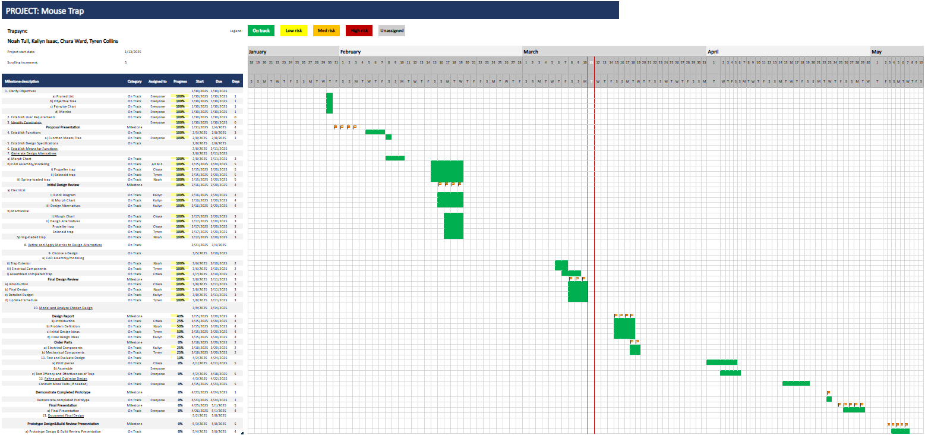
Gantt Chart
Notes:
TC

Slide 48
Gantt Chart
Notes:
Chara

Slide 49
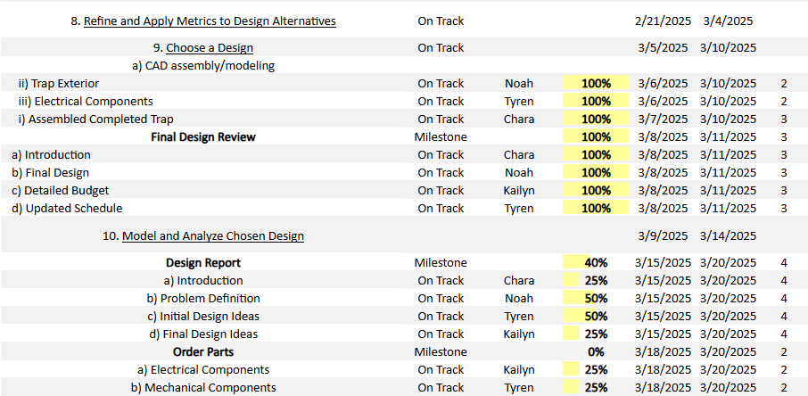
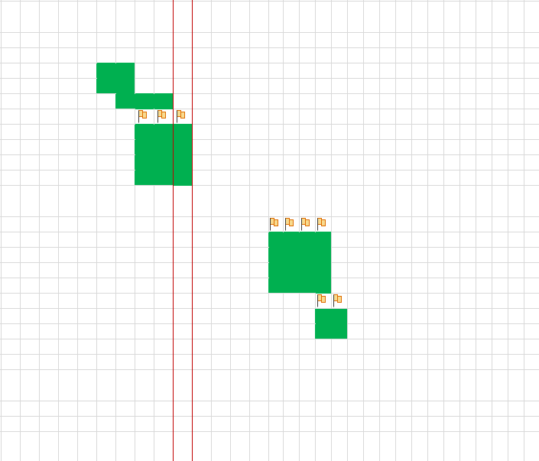
Gantt Chart
Notes:
Chara

Slide 50
Gantt Chart
Notes:
TC

Slide 51
Gantt Chart
Notes:
TC

Slide 52
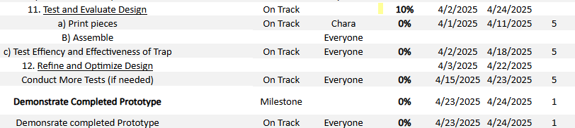
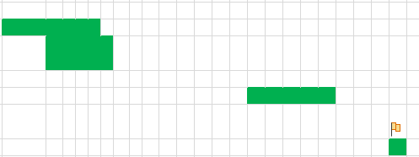
Gantt Chart
Notes:
TC

Slide 53
Gantt Chart
Notes:
TC

Slide 54
Gantt Chart
Notes:
TC

Slide 55
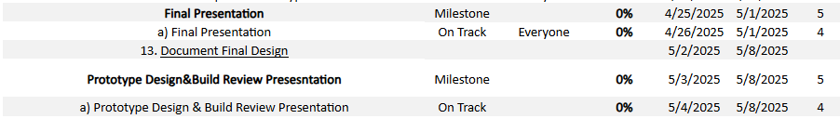
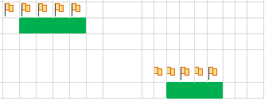
Gantt Chart
Notes:
TC

Slide 56

Thank You!
Notes:
Everybody

